Slide 1





WASTE AND
SUSTAINABILITY IN
HOSTEL
PRESENTED BY
VIDYASAAGAR S
VIGNESHWAR J VIGNESHWARAN V VIMAL AANANTH BR

Slide 2









PRESENTATION
OVERVIEW
OBJECTIVE
BRAIN – STORMING
MIND MAPPING
5 W’S & 1 H MATRIX TABLE
USER - PARTICIPANT
MAPPING
CONTEXTUAL INQUIRY

Slide 3
PRESENTATION
OVERVIEW
QUESTIONNAIRES AND CUE CARDS
ACTIVITY – MAPPING
PERSONAS AND OIOR
TABLE

Slide 4












OBJECTIVE
To apply design thinking principles to create innovative and sustainable solutions for waste management in hostels, aiming to minimize waste generation, promote recycling, and reduce environmental impact while enhancing the living experience for residents. This will involve identifying key challenges, empathizing with user needs, ideating practical solutions, prototyping waste- reduction systems, and implementing eco-friendly practices within hostel environments.

Slide 5










BRAIN -STORMING

Slide 6
KEYWORDS
Recycling
Zero waste
Upcycling
Energy efficiency
Composting
Renewable energy
Waste segregation
Solar power
Waste reduction initiatives
Carbon footprint

Slide 7
KEYWORDS
Digital detox
Green cleaning
Community gardens
Traffic Prediction
Water conservation
Eco-friendly amenities
Greywater systems
Biodegradable products
Low-flow fixtures
Green certifications

Slide 8
Waste Management
Energy Efficiency and
Renewable Energy
Water Conservation
Sustainable Practices
Community and Environmental
Engagement
Recycling
Energy efficiency
Water conservation
Sustainable sourcing
Digital detox
Composting
Renewable energy
Greywater systems
Green cleaning
Community gardens
Eco-friendly
amenities
Waste segregation
Solar power
Low-flow fixtures
Upcycling
Waste reduction
Biodegradable products
Carbon footprint
initiatives
Zero waste
Green certifications

Slide 9








MIND MAPPING

Slide 10

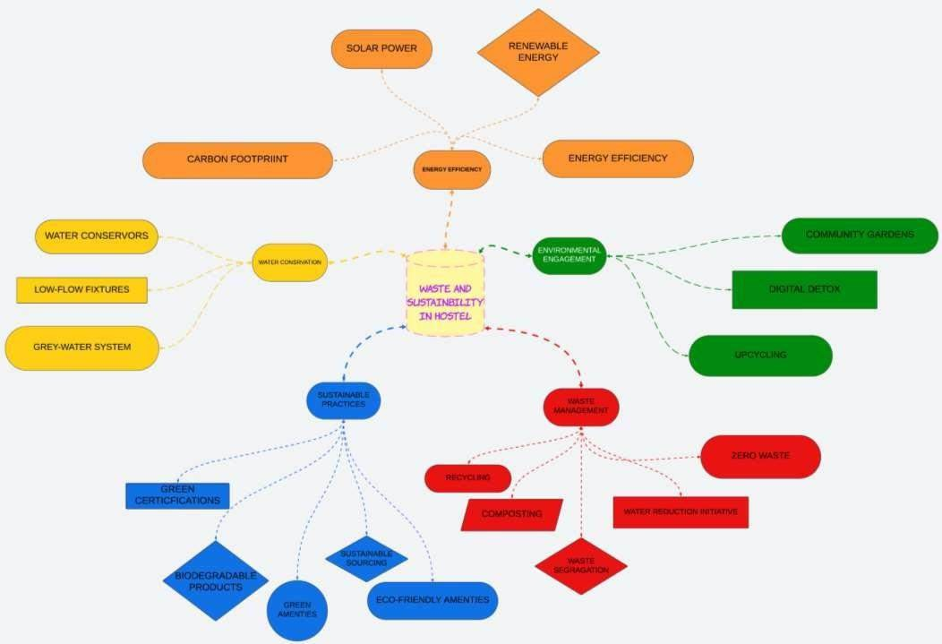

Slide 11

5 W’S & 1 H MATRIX TABLE

Slide 12
TABLE CONTENTS | WASTE MANAGEMENT | ENERGY EFFICIENCY & RENEWABLE ENERGY | WATER CONSERVATION | SUSTAINABLE PRACTICES | COMMUNITY & ENVIRONMENTAL ENGAGEMENT
WHAT? | Proper disposal and recycling of waste. Segregation of organic and inorganic waste. | Use of energy- efficient appliances. | Efficient water usage. Use of water-saving devices. | Practices that minimize environmental impact. Eco-friendly products and methods. | Participation in environmental awareness programs. .
WHO? | Housekeeping staff. Hostel residents. | Energy consultants. Hostel residents. | Plumbers and maintenance staff. | Hostel management. Residents. | Hostel management. Residents. Local
WHERE? | Hostel premises (rooms, common areas). | Throughout the hostel (common areas, rooms, rooftops). | Bathrooms, kitchens, gardens. | All areas of the hostel (indoor and outdoor). | Within the hostel and in the local community.

Slide 13
TABLE CONTENTS | WASTE MANAGEMENT | ENERGY EFFICIENCY & RENEWABLE ENERGY | WATER CONSERVATION | SUSTAINABLE PRACTICES | COMMUNITY & ENVIRONMENTAL ENGAGEMENT
WHEN? | Daily waste disposal. Periodic recycling collection. | Daily energy monitoring. | Daily water usage monitoring. Regular inspection of water-saving devices. | Daily sustainable practices. Regular training sessions. | Throughout the year, especially during specific campaigns or events.
WHY? | To ensure proper waste disposal and recycling. | To reduce energy consumption and costs. | To reduce water wastage. | To reduce the hostel's environmental footprint. | To engage residents in sustainable practices.
HOW? | Segregating waste at the source. . | Installing energy- efficient appliances. | Installing water- saving devices. | Implementing eco- friendly practices. | Organizing workshops and seminars.

Slide 14

USER - PARTICIPANT MAPPING

Slide 15



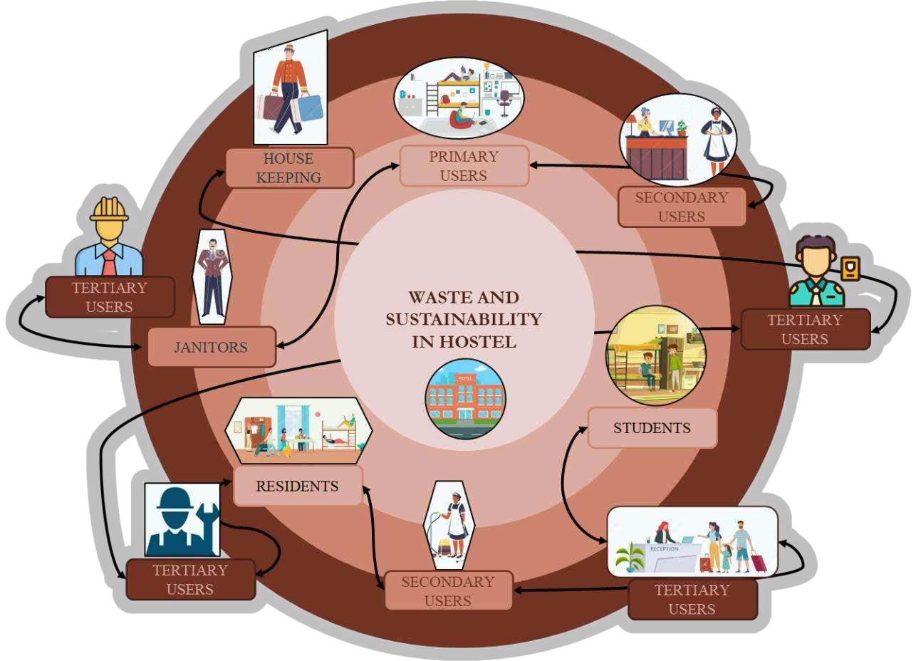









MAPPING

Slide 16
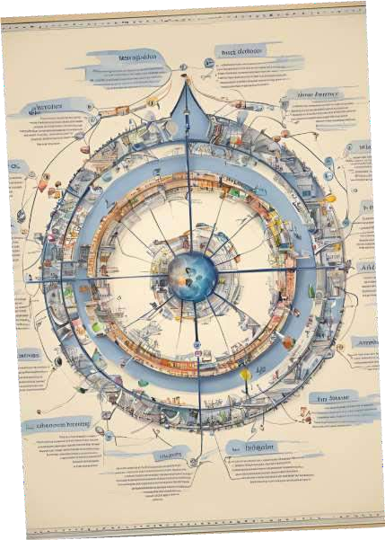
CONTEXTUAL INQUIRY

Slide 17
PIE CHART BASED ON USERS
BAR CHART BASED ON GENDER
80
70
60
50
40
30
20
10
0
HOSTEL MANAGEMENT
STUDENTS/RESIDENTS
HOSTEL STAFF
Students/Residents
Hostel Staff
Male
Hostel Management
Female

Slide 18
CONTEXTUAL MODEL
Start
Data Analysis
Data Collection
Preprocessing
Waste Generation Trends Recycling Rates Efficiency of Current
Types of Waste Volume of Waste
Segregate Waste Data Analyze Waste Patterns
System Optimization
Decision Making
Feedback Loop
Improve Segregation Implement Composting
Set New Targets Develop Awareness Programs
Monitor System Performance
Collect Resident Feedback
End

Slide 19


QUESTIONNAIRES AND CUE CARDS

Slide 20
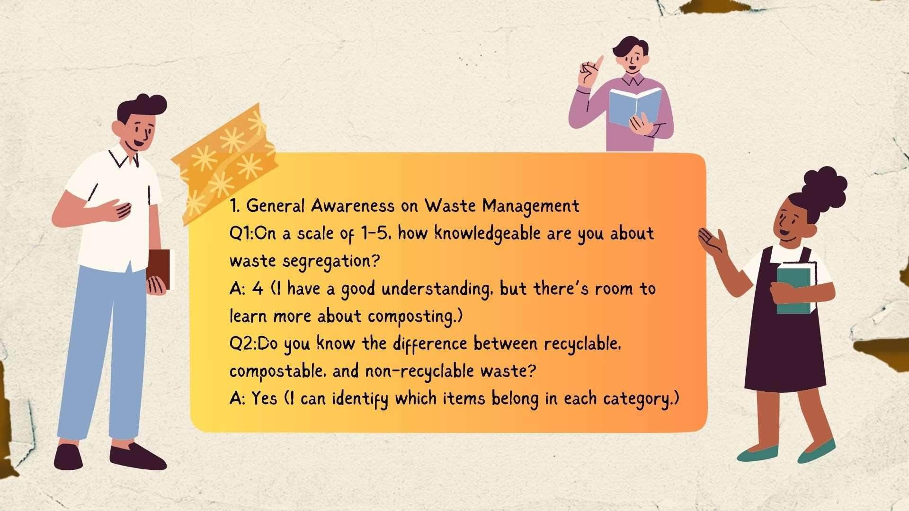

Slide 21
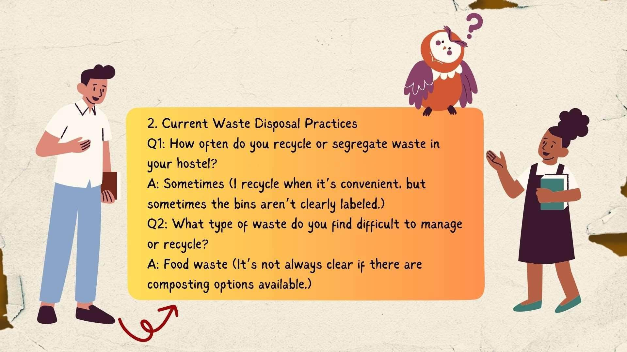

Slide 22
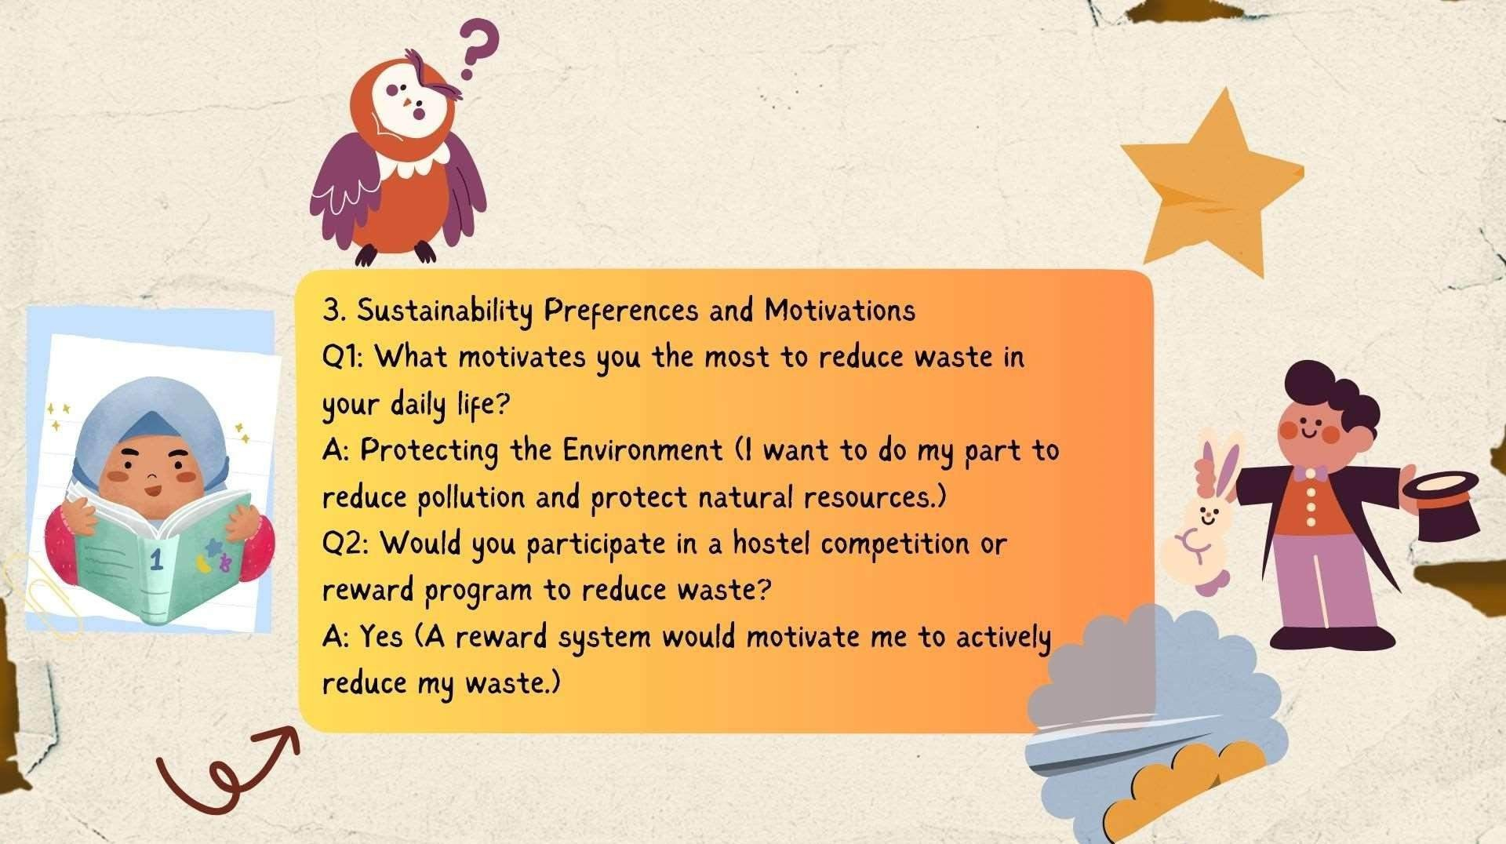

Slide 23
CUE - CARDS
Sample Cue Cards:
Waste Segregation:
What challenges do you face when segregating waste in the
hostel?
How can the hostel make recycling easier for residents?
Single - Use vs. Reusables:
What single-use items do you rely on, and could these be replaced with reusable alternatives?
What kind of reusable items would you be willing to adopt in your daily life?

Slide 24


ACTIVITY - MAPPING

Slide 25








ACTIVITY - MAPPING
Waste Generation
Waste Handling and
Management
Energy and Water Use
Monitoring and
Evaluation
Sustainable Practices
Collaborations

Slide 26
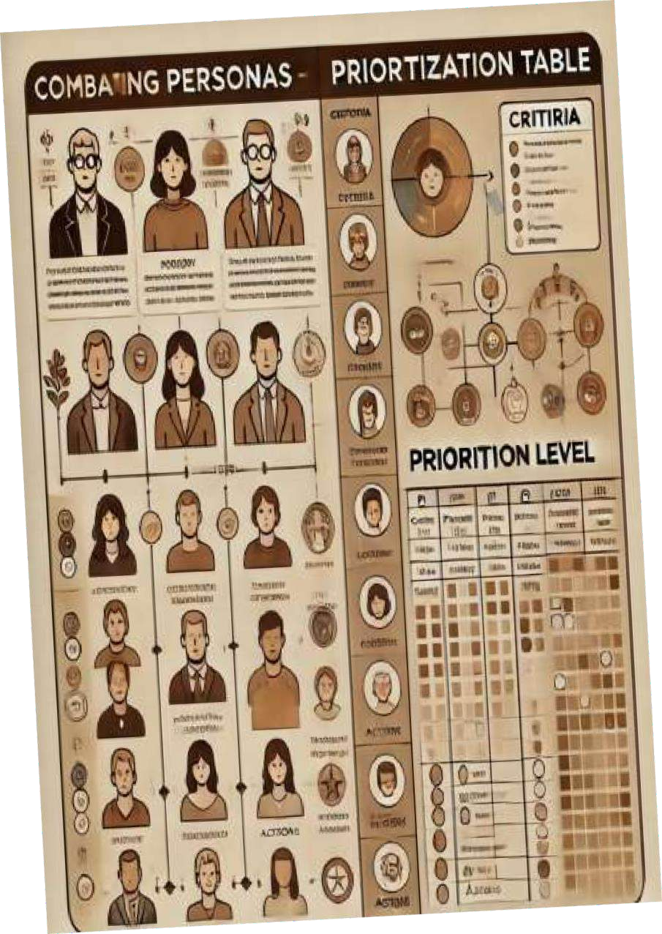
PERSONAS AND OIOR TABLE

Slide 27
PERSONAS
Persona 1: Eco-Conscious Student
Name: Anaya Sharma
Age: 21
Background: Environmental Science Major, Senior Year
Lifestyle: Lives in a shared hostel room, actively participates in campus environmental clubs.
Goals:
Minimize waste generation in her hostel.
Promote recycling and composting practices among her peers.
Lead workshops on sustainable living and waste
management.
Frustrations:
Lack of clear signage for waste disposal and recycling in the hostel.
Limited access to composting facilities and information on how to compost effectively.
Motivations:
Strong belief in making a positive impact on the environment.
Desire to inspire and lead her peers in adopting sustainable practices.
Preferred Communication Channels:
Social media groups and campus bulletin boards for sharing information.
Informal gatherings or workshops for hands-on learning.
Persona 2: Busy Student
Name: Rahul Verma
Age: 22
Background: Business Administration Major, Junior Year
Lifestyle: Juggles academics, part-time job, and extracurricular activities, living in a hostel.
Goals:
Find quick and convenient ways to manage waste and live sustainably.
Balance a busy schedule while contributing to sustainability
efforts.
Often feels overwhelmed by sorting waste correctly due to lack of time.
Finds it difficult to engage in sustainability initiatives that require a significant time commitment.
Wants to contribute positively to the environment without
adding stress to his busy life.
Interested in easy-to-implement solutions for reducing waste, like using reusable containers.
Preferred Communication Channels:
Short, informative videos and infographics shared via social media or group chats.
Easy-to-follow checklists or guides that can be posted in common areas of the hostel.
Frustrations:
Motivations:

Slide 28
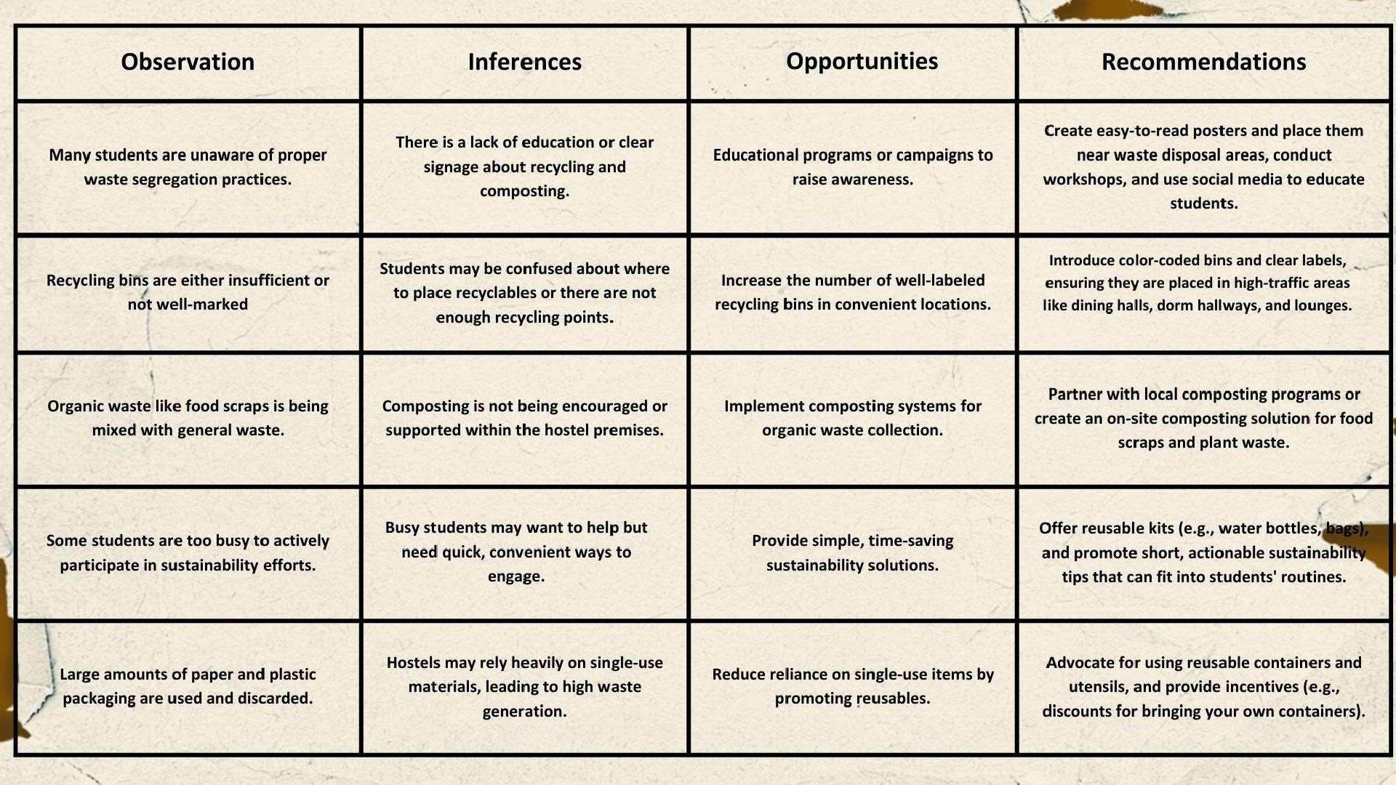

Slide 29
THANK YOU!

